Slide 1
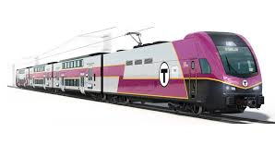
Hypotheses
MBTA Transportation
Python for Data Science and AI
GROUP 4
-Suzuki Kaori 21224038
-Shrestha Roji 22224045

Slide 2









  Table Of Content
01
02
03
04
First Hypothesis
Second
Hypothesis
Introduction
Conclusion

Slide 3

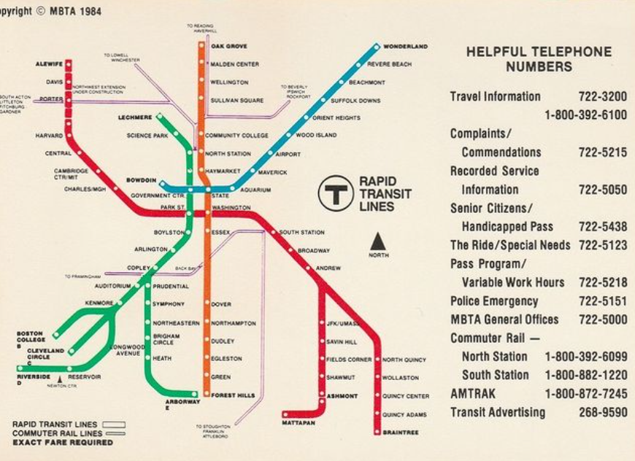
What is MBTA?
•The Massachusetts Bay Transportation Authority (MBTA) provides public transit services including subway, bus, commuter rail, and ferry routes in the Greater Boston area.
•The CR-Providence line is part of the commuter rail network connecting Boston with southern Massachusetts and Rhode Island.

Slide 4

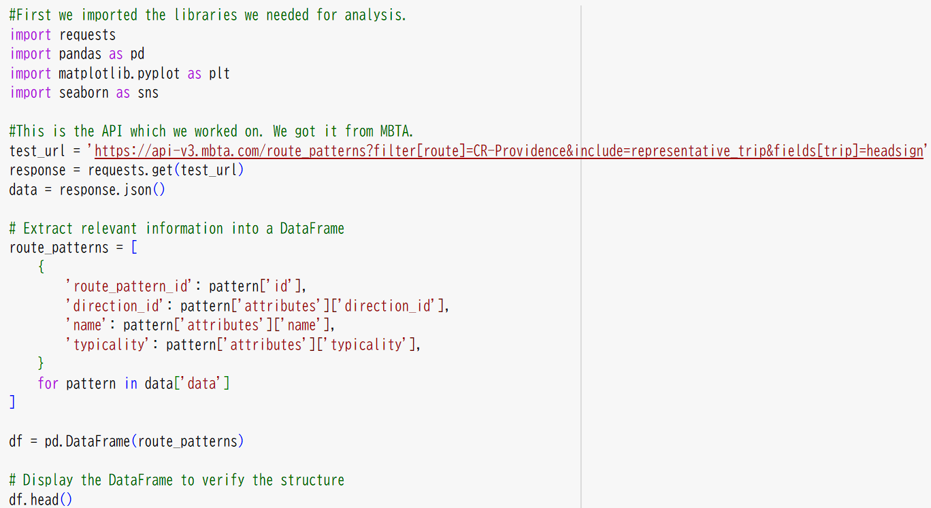


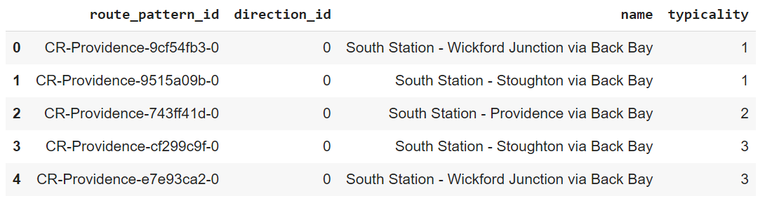


Slide 5
Research question 1: Is there a correlation between direction (inbound or outbound) and the typicality of routes in the CR-Providence route patterns?
Hypothesis 1: Routes with higher typicality scores are more likely to be inbound (direction_id = 0).
Null-hypothesis 1: There is no correlation between direction (inbound or outbound) and the typicality of routes in the CR-Providence route patterns.

Slide 6
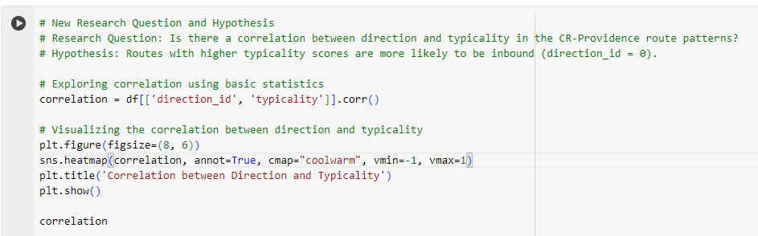

Slide 7
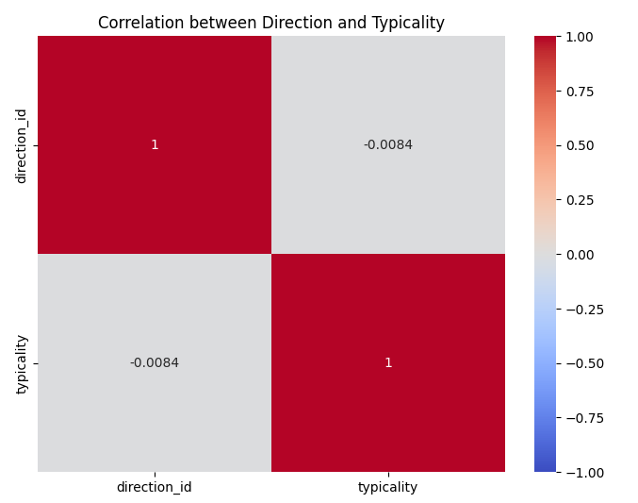
Hypothesis 1
  The correlation score between direction and typicality is -0.008, which indicates almost no linear correlation between these two variables.
  The direction (whether the route is inbound or outbound) does not appear to be related to the typicality score. Thus, the hypothesis is not supported by the data .

Slide 8
Research question 2: Are certain route patterns more frequent in the data?
Hypothesis 2: Specific patterns such as "South Station - Wickford Junction" appear more frequently.
Null Hypothesis 2: All route patterns in the CR-Providence data are equally frequent, with no specific patterns appearing more frequently than others.

Slide 9
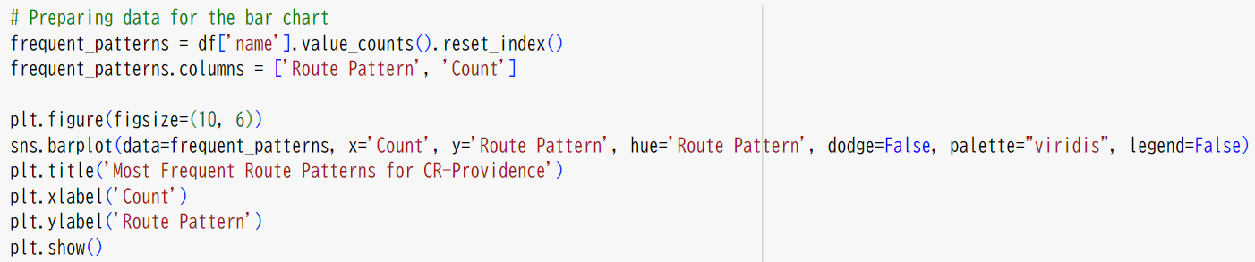


Slide 10
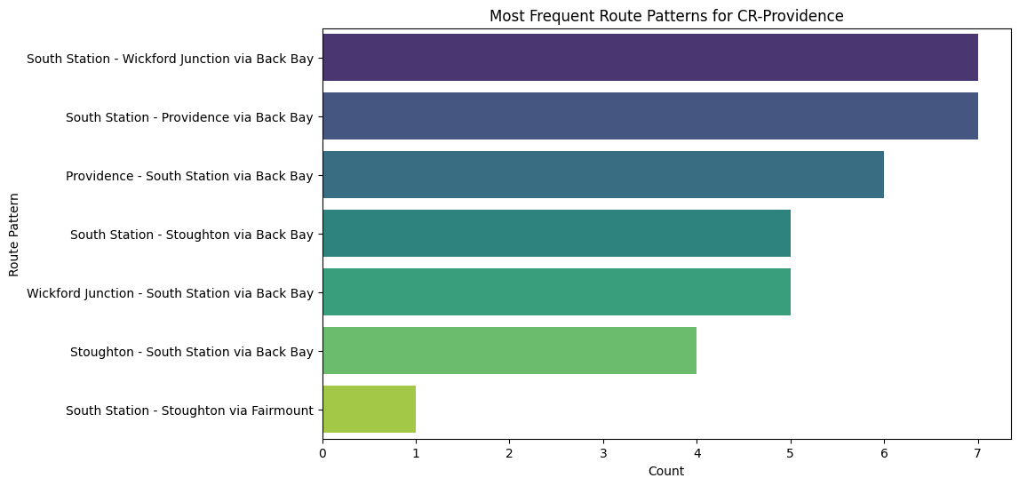
Hypothesis 2
The bar plot of route patterns shows that "South Station - Wickford Junction via Back Bay" and similar patterns have higher number.
This confirms that certain route patterns are indeed more frequent than others. Our hypothesis is supported.

Slide 11
There is almost no linear correlation between direction and typicality score. (null-hypothesis)
01.
Conclusion
From the visualizations, we found out that:
Specific patterns such as "South Station - Wickford Junction" appear more frequently. (hypothesis)
02.

Slide 12

Reference (APA)
Massachusetts Bay Transportation Authority. (n.d.). MBTA API v3. https://api-v3.mbta.com/ Retrieved October 13, 2024.

Slide 13
Thank you very much!

